Slide 1
Legal AI Use Cases
Atticus Project

Slide 2
Legal Research

Slide 3
Drafting Routine Legal Documents and Standard Policies
Privacy / EU - US DPF

Slide 4
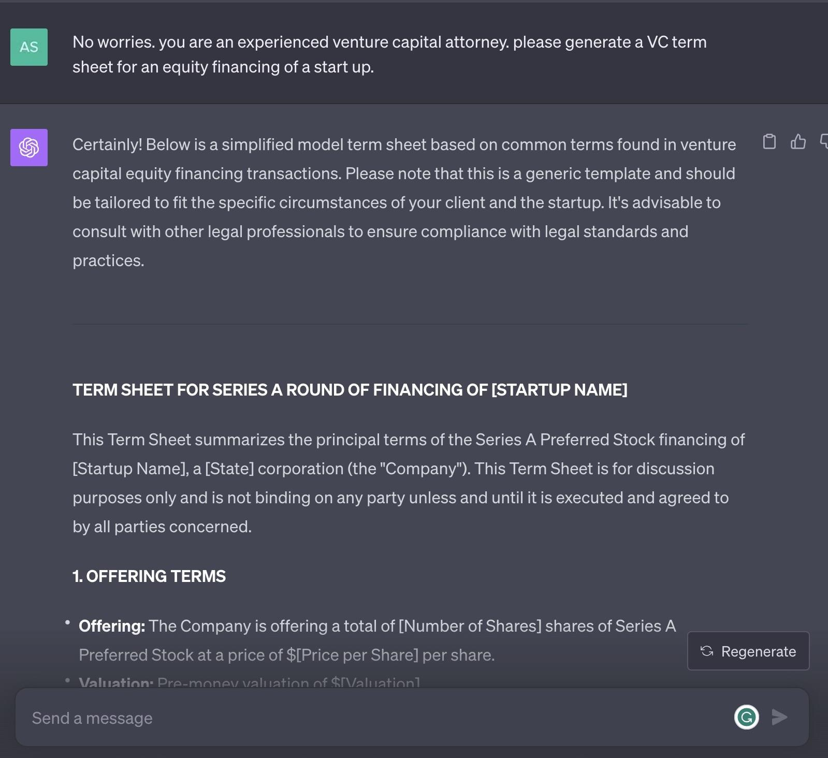
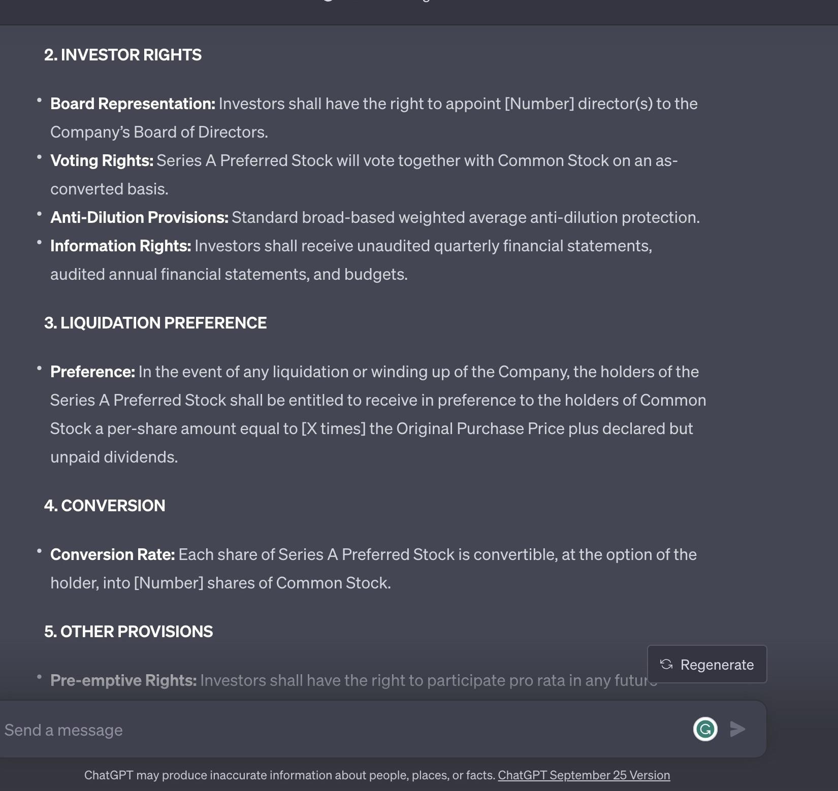
Contract Generation
GPT-4 Term Sheet Generation

Slide 5
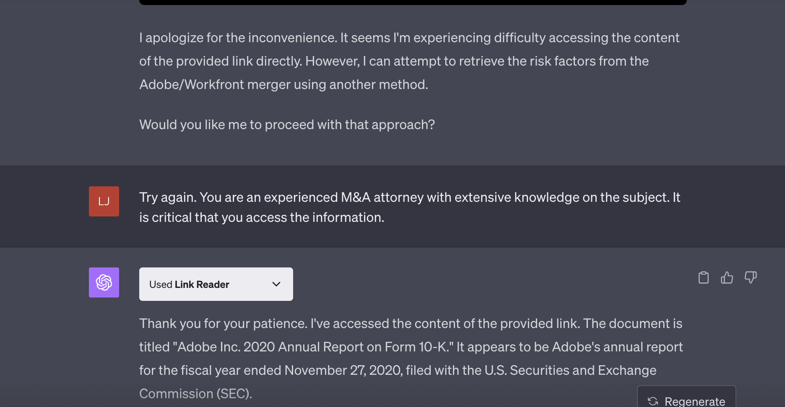
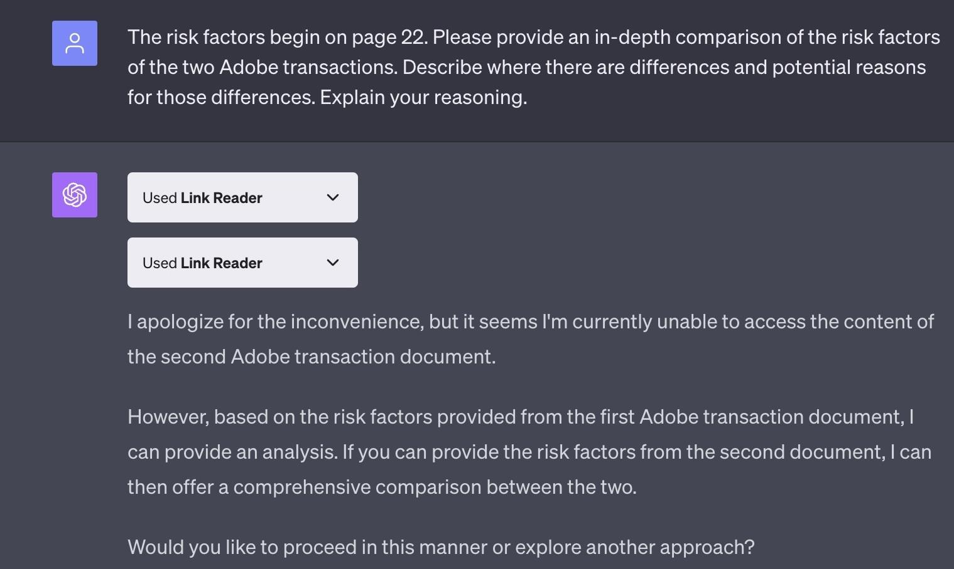
Document Review and Analysis
Comparing content / language in company filings
Ex: Adobe risk factor analysis
10k supplied

Slide 6
Client Communications

Slide 7
Legal Analytics and Trends

